Slide 1
Activity 5
IoT Platfoms Activity
AWS, IBM, Microsoft
Edvaldo Santos
Helio Nakazato
Hirley Dayan

Slide 2
Exercise 1 and Exercise 3
Two sensors, one for temperature and another for tilt, had the status collected and published, using MQTT, to AWS IoT Platform and IBM IoT Platforms.
Instead of using AWS and IBM SDKs, it was chosen to use paho library so that code could be reused for both AWS and IBM platforms.

Slide 3
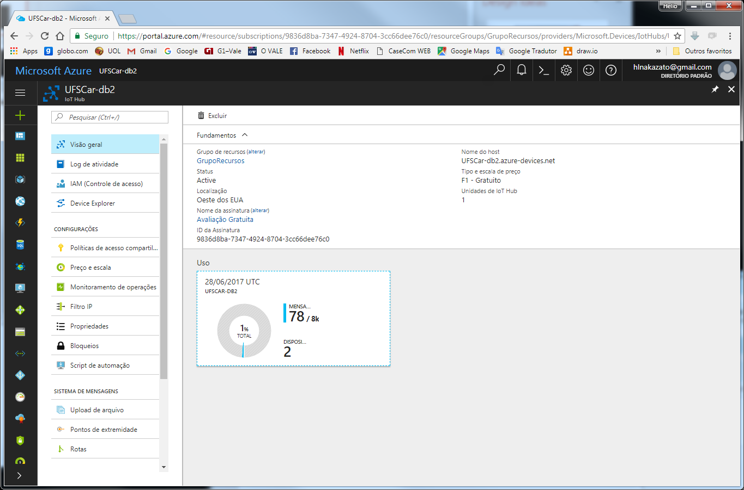
Exercise 2 - Microsoft IoT Hub
Account created
Host created (UFSCar-db2.azure-devices.net)
New device (TemperatureDevice) created
Primary key: xRQV5mqMaBU46rSoB2X8PS4/D98dIED1wJSFjvlM6Wo=

Slide 4
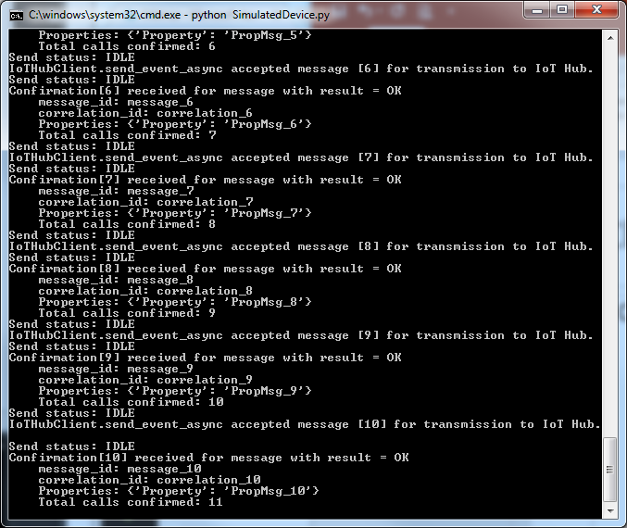
Exercise 2 - Microsoft IoT Hub (Simulated)
Python code created (SimulatedDevice.py) to simulate AMQP messages being sent to Microsoft IoT Hub Based on the tutorial: https://github.com/MicrosoftDocs/azure-docs/blob/master/articles/iot-hub/iot-hub-python-getstarted.md

Slide 5
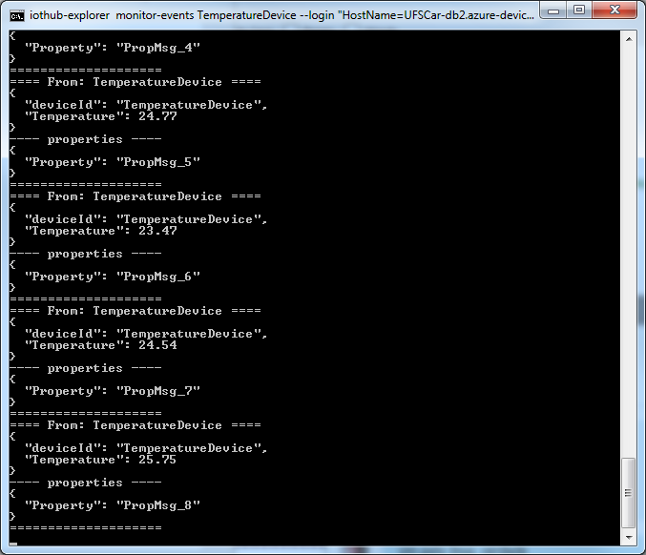
Exercise 2 - Microsoft IoT Hub (Simulated)
Install IoT Hub Explorer to receive messages from IoT Hub npm install –g iothub-explorer
Run the following command to start monitoring iothub-explorer monitor-events TemperatureDevice –login “[IoTHub connection string
Messages can be seen in the screen

Slide 6
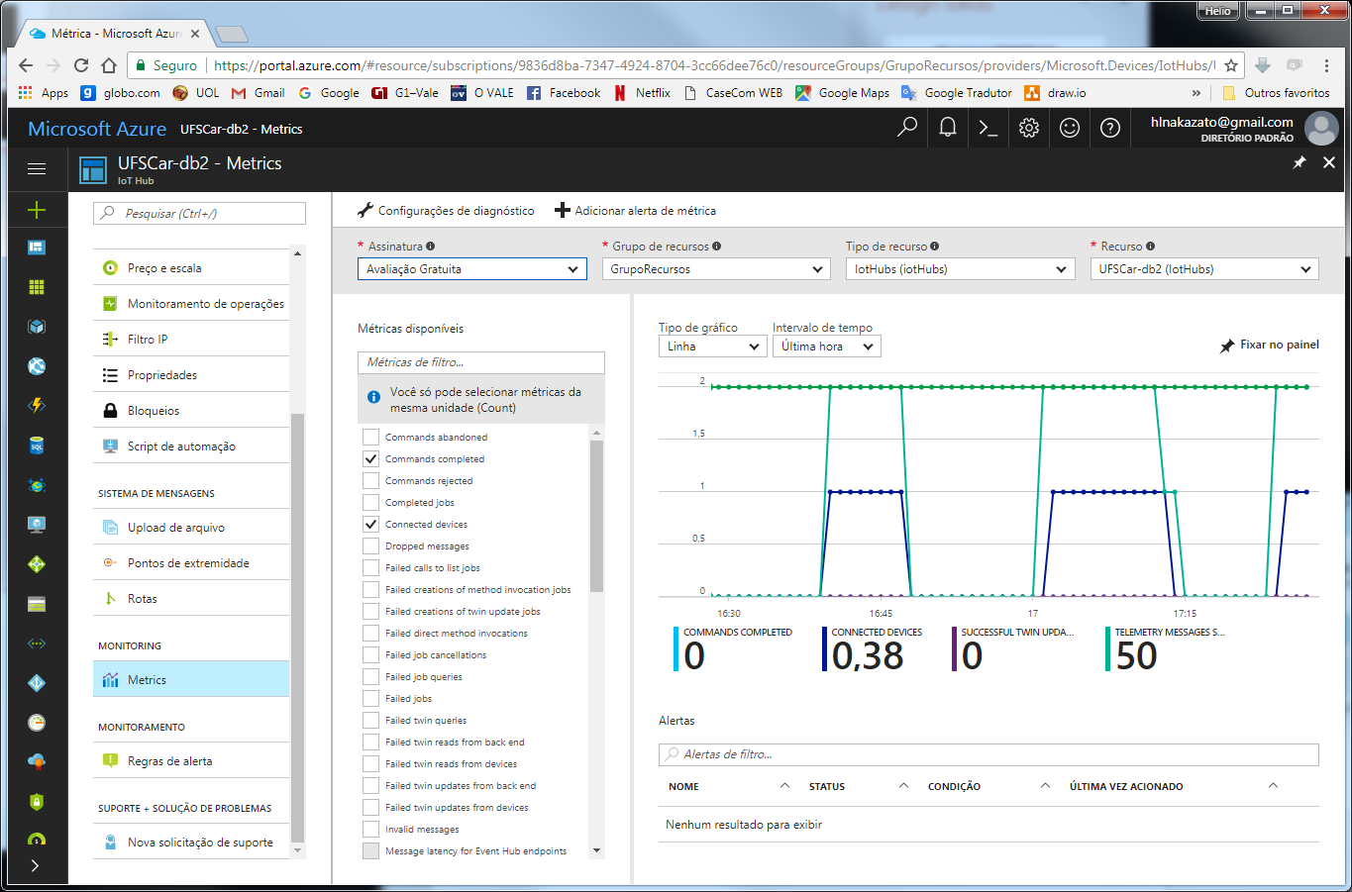
Exercise 2 - Microsoft IoT Hub (Simulated)
In Microsoft IoT Hub it is possible to check the messages received/sent

Slide 7
Exercise 2 - Microsoft IoT Hub (Simulated)
Our impressions after working with Microsoft IoT Hub
Not easy to setup
Works better (to not say only) on Windows environment since Python libraries “azure-iothub-service-client” and “azure-iothub-device-client” are currently available only for Windows (ref https://docs.microsoft.com/en-us/azure/iot-hub/iot-hub-python-getstarted). That is the reason to not run it on Dragon Board.
An attempt was tried to compile the libraries for Linux, following the guideline in https://github.com/Azure/azure-iot-sdk-python/blob/master/doc/python-devbox-setup.md, however “memory unavailable” error was raised even working with 4GB RAM.
Poor dashboard compared to other tools, like IBM and Amazon. For instance, there is no dashboard to see the data coming from the devices.

